Slide 1
PREDICTION OF ANDROID RANSOMWARE ATTACK USING CATEGORIAL CLASSIFICATION
DOMAIN : Machine Learning
BATCH : A9
PROJECT GUIDE : Dr. K.Sangeetha
TEAM MEMBERS : Abirami R(211420104006)
Kalai Arasi R (211420104117)
Muthu Usha Rani M (211420104173)
SDG GOALS : Goal 8(Decent work and Economic Development)

Slide 2
AGENDA
Abstract
Existing System
Proposed Methodology
Literature Survey
Technology Requirements
System Architecture
Module Description
Diagrams
Screenshots
Conclusion
Future Work

Slide 3
ABSTRACT
Ransomware attacks pose a significant cybersecurity risk, causing significant financial losses.
This study proposes an abstract machine learning method to predict Android ransomware on Android devices.
The method uses abstract features from system logs, network traffic, and application behavior, including permission requests, communication patterns, file access, and API calls.
The model is trained using a tagged dataset of known ransomware samples and authentic Android applications.

Slide 4
EXISTING SYSTEM
In order for apps to utilise the different features offered by the system services, Android permits apps to interact with its system services through system service assistants.
In the interim, the system services depend on their service assistants to implement security audits for safeguarding.
Unfortunately, it is possible to directly abuse hidden APIs to get around the security checks in the service helpers and this would compromise stability and provide serious security risks like privilege escalation, automatic function execution without user input, crashes, and denial-of-service attacks.
In order to solve this issue, Google has suggested a number of strategies, such as patching issues one at a time or even creating a blacklist that would ban any hidden APIs.
The limitations of hidden APIs can still be circumvented by developers, though, as long as they can find novel ways to use these hidden APIs.

Slide 5
DEMERITS
They did not compared more than one algorithm for getting better accuracy level.
Diagrams and graphs with performance and confusion measurements were not made by them.
Both the performance and accuracy levels are low.
The data was improperly trained to the computer.

Slide 6
PROPOSED SYSTEM
Using machine learning techniques, the proposed approach seeks to forecast the likelihood of Android ransomware on Android devices.
The system can detect possible infections by assessing different traits and patterns, allowing users to take the necessary precautions to lessen the risks.
In Data Collection,system logs, network traffic and other pertinent sources among the pertinent data that the system are gathered from the Android device and machine learning algorithms use this data as their input.
In the Feature Extraction process, abstract features are taken out from the gathered data to differentiate between Android ransomware and legal apps.
The process of preparing a dataset entails labelling a collection of legal Android applications and known instances of Android ransomware and the tagged data is used to train the abstract machine learning model collection.

Slide 7
MERITS
We compared three different algorithms for getting better accuracy level.
We produced graphs and infographics using performance and confusion measurements.
We successfully trained the computer on the data and almost 80% to 90% of the trained data is available.
Both performance and accuracy levels were raised and our accuracy level will between 95%-98%.

Slide 8
LITERATURE SURVEY
Title: A note on machine learning applied in ransomware detection
Author: Manuela Horduna , Simona-Maria L˘az˘arescu , and Emil Simion
Year: 2022
Algorithm:
Decision Tree Algorithm: The assessment demonstrates a lightweight and accurate PDF detection system, achieving a 98.84% prediction accuracy with a short prediction interval of 2.174 µSec.
Random Forest Algorithm:The random forest prediction is based on the majority voting for the result of the combination predictions of multiple decision trees. The experimental evaluation revealed that the proposed method could achieve a high accuracy of 97.74% for the detection of ransomware.

Slide 9
LITERATURE SURVEY
Title: Opportunities for Early Detection and Prediction of Ransomware Attacks against Industrial Control Systems
Author: Mazen Gazzan and Frederick T. Sheldon
Year: 2022
Algorithm:
Generative Adversarial Networks (GAN) are used to generate artificial ransomware examples that represent the future behavior of the attacks.
Light gradient-boosting decision tree was used by to predict future malware attacks on cloud systems.
The model uses malware behavioral data to train the decision tree classifiers.
The study developed a regression-based neural network model to forecast short-term ransomware behavior based on historical time-series data.

Slide 10
LITERATURE SURVEY
Title: Detecting Malicious Accounts in Online Developer Communities Using Deep Learning
Author: Qingyuan Gong, Yushan Liu, Jiayun Zhang, Yang Chen
Year : 2021
Proposed Methodology:
GitSec, a deep learning-based solution for detecting malicious accounts in online developer communities.
It applies a parallel neural network design with an attention mechanism to process the sequences.
It uses graph neural networks and structural hole theory are employed to deal with the two constructed graphs.
GitSec makes use of the descriptive features to enhance the detection performance.
The final judgement is made by a decision maker implemented by a supervised machine learning-based classifier.

Slide 11
LITERATURE SURVEY
Title: Analysis, Detection, and Classification of Android Malware using System Calls
Author: Shubham Shakya and Mayank Dave
Year : 2020
Proposed Methodology:
Logs collected during the app runtime are analyzed and fed to different machine learning models for Detection and Family classification of Malware.
The result indicates that K-Nearest Neighbor and the Decision Tree gave the highest accuracy in malware detection and Family Classification respectively.

Slide 12
LITERATURE SURVEY
Title: MACHINE LEARNING METHODS FOR MALWARE DETECTION AND CLASSIFICATION
Author: Kateryna Chumachenko
Year: 2017
Proposed Methodology:
The purpose of this work was to determine the best feature extraction, feature representation, and classification methods that result in the best accuracy when used on the top of Cuckoo Sandbox.
Specifically, k-Nearest-Neighbors, Decision Trees, Support Vector Machines, Naive Bayes and Random Forest classifiers were evaluated.
This work presents recommended methods for machine learning based malware classification and detection, as well as the guidelines for its implementation.

Slide 13
ENVIRONMENT REQUIREMENTS
Hardware requirements:
Hard disk : Minimum 80 GB
RAM : Minimum 4 GB
Software Requirements:
Tool : Anaconda with Jupyter Notebook
Front End : HTML, CSS, JavaScript, Bootstrap
Database : SQLite
Languages Used : Python,Django

Slide 14
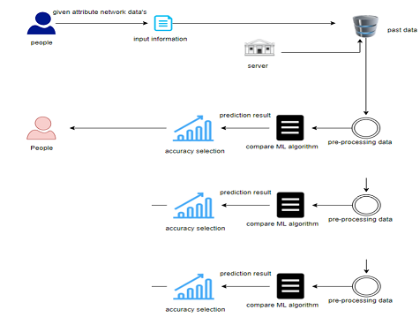
SYSTEM ARCHITECTURE
Bernoulli NB Algorithm
XG Boost Algorithm
Random Forest Algorithm

Slide 15
LIST OF MODULES
Data pre-processing
Data Analysis or Visualization
Bernoulli Naïve Bayes Algorithm
Xgboost Algorithm
Random Forest Algorithm
Deployment

Slide 16
MODULE-1: DATA PRE-PROCESSING
The process involves importing library packages, loading a dataset, analyzing variable identification, and evaluating missing or duplicate values.
A validation dataset is used to estimate model skill and tune models.
Data cleaning is done by renaming and dropping columns to analyze uni-variate, bi-variate, and multi-variate processes, aiming to detect errors and anomalies.
DATASET LINK:
https://www.kaggle.com/datasets/blackarcher/malware-dataset?select=Malware+dataset.csv

Slide 17


MODULE DIAGRAM
Data Preprocessing
Module
Input Dataset
Processed
Data
Sample Input Dataset

Slide 18
MODULE 2:DATA ANALYSIS OR VISUALIZATION
Data visualization is crucial in applied statistics and machine learning for gaining qualitative understanding of data.
It helps identify patterns, corrupt data, outliers, and more.
Data visualizations can be used to express key relationships in visceral plots and charts.
Understanding various types of plots, such as line, bar, histogram, and box plots, is essential for better understanding data.
This skill is essential for exploring datasets, identifying patterns, and demonstrating key relationships.

Slide 19
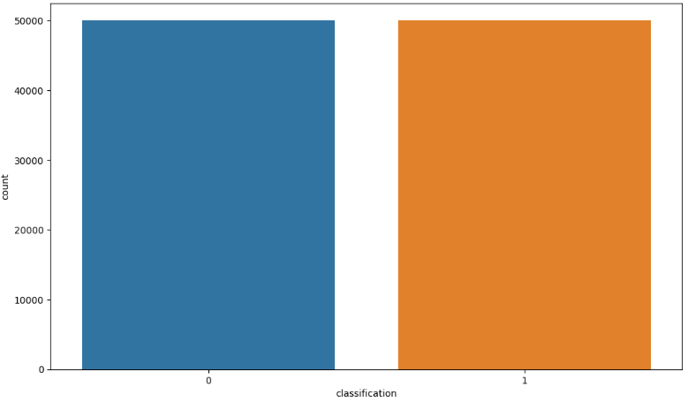
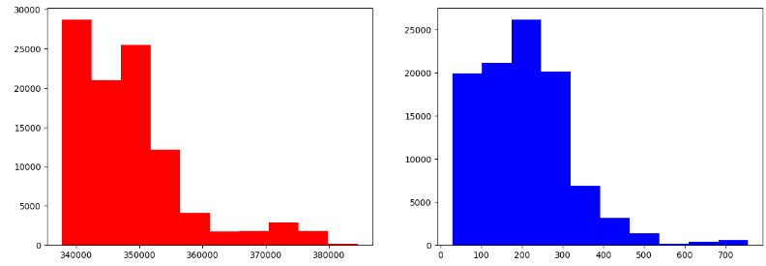
Plot chart representation for the classification of data
Bar chart Representation

Slide 20
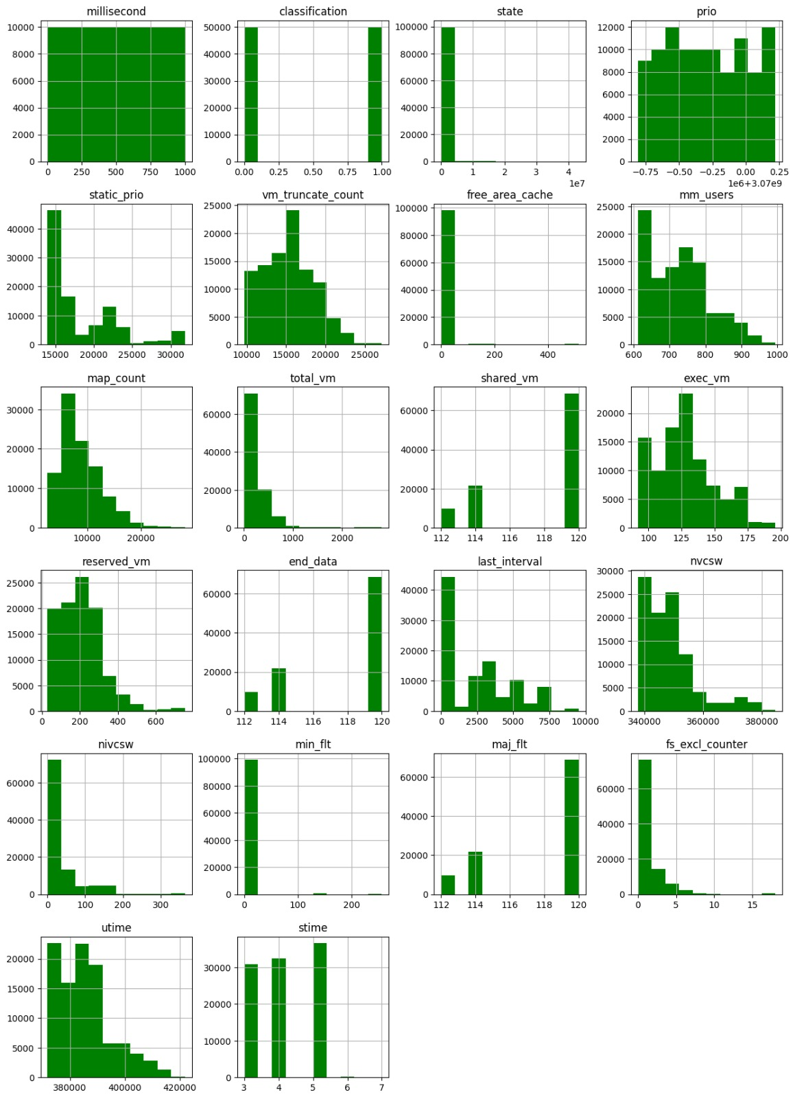
Histogram reprsentation of the columns in the dataset.

Slide 21
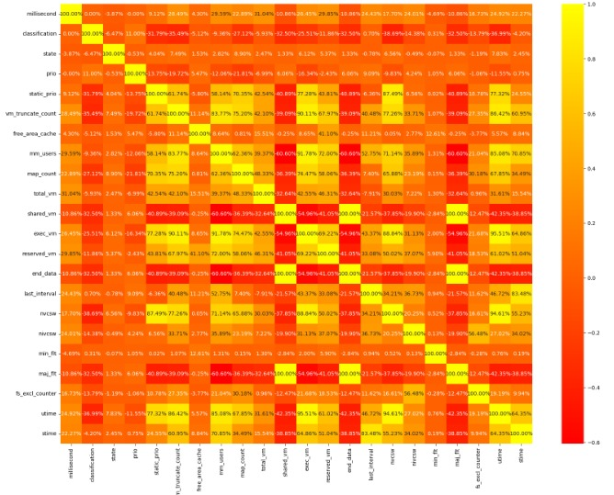
Heat Map Representation

Slide 22
MODULE 3: BERNOULLI NAÏVE BAYES ALGORITHM
The Bernoulli Naive Bayes (BernoulliNB) algorithm is a binary classification method based on the principles of Naive Bayes theorem.
It calculates the probability of a data point belonging to a particular class based on its features.
BernoulliNB is particularly suitable for datasets with binary features, which represent the presence or absence of certain attributes.
It assumes feature independence, simplifying probabilities.
The predicted class is chosen based on the highest posterior probability, and Laplace smoothing is applied to avoid zero probabilities in cases where a feature hasn't been observed.

Slide 23
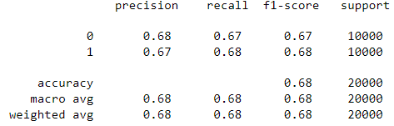
CLASSIFICATION REPORT OF BERNOULLI NAÏVE BAYES:
CONFUSION MATRIX SCORE OF BERNOULLI NB:
[[6681 3319]
[3166 6834]]
CROSS VALIDATION TEST RESULT OF ACCURACY : [65.15 69.755 67.935 63.19 44.19 ]
ACCURACY SCORE OF BERNOULLINB IS : 67.575
HAMMING LOSS OF BERNOULLINB IS : 32.425

Slide 24
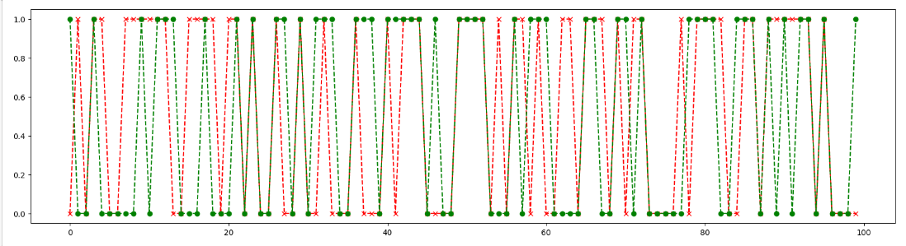
GRAPH REPRESENTATION

Slide 25
MODULE 4: XG BOOST ALGORITHM
XGBoost is a widely used machine learning algorithm known for its efficiency in tasks like classification, regression, and ranking.
It is based on the gradient boosting framework and uses L1 and L2 regularization terms to prevent overfitting.
XGBoost can handle missing data internally and is designed for efficient parallel and distributed computing.
It assesses feature importance, employs tree pruning to prevent overfitting, and uses cross-validation to ensure robustness.
XGBoost is actively maintained and updated by the open-source community, ensuring ongoing improvements and compatibility with technological advancements.
Its versatile application across various domains and easy integration with popular libraries and frameworks like scikit-learn make it a popular choice for data science competitions and real-world applications.

Slide 26
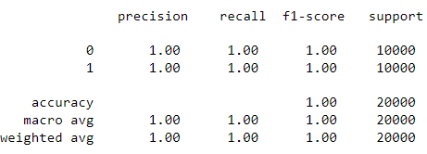
CLASSIFICATION REPORT OF XG BOOST ALGORITHM:
CONFUSION MATRIX SCORE OF BERNOULLI NB:
[[10000 0]
[ 0 10000]]
CROSS VALIDATION TEST RESULT OF ACCURACY : [86.63 89.405 84.065 79.54 85.775]
ACCURACY SCORE OF BERNOULLINB IS : 100.0
HAMMING LOSS OF BERNOULLINB IS : 0.0

Slide 27
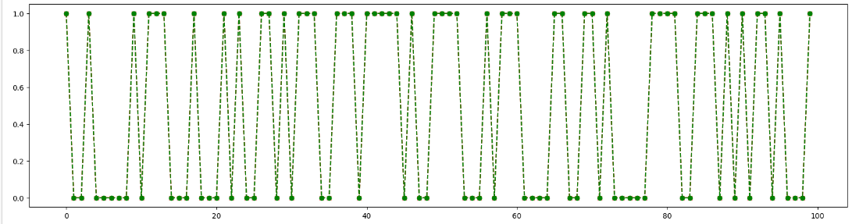
GRAPH REPRESENTATION

Slide 28
MODULE 5: RANDOM FOREST ALGORITHM
A Random Forest Classifier is a machine learning algorithm used for classification and regression tasks.
It consists of multiple decision trees, each with a slightly different subset of training data and features.
The algorithm uses random subsampling, or "bootstrap sampling," to introduce diversity among the trees, reducing the risk of overfitting.
Feature randomization introduces randomness and decorrelates the trees, making them less likely to make the same errors.
Once all the trees are constructed, they can be used to make predictions.
For classification tasks, the final prediction is the class with the most votes across all trees.
Random Forests have several hyperparameters that can be tuned to optimize performance.

Slide 29
CLASSIFICATION REPORT OF XG BOOST ALGORITHM:
CONFUSION MATRIX SCORE OF BERNOULLI NB:
[[10000 0]
[ 0 10000]]
CROSS VALIDATION TEST RESULT OF ACCURACY : [89.62 89.775 90.705 90. 95. ]
ACCURACY SCORE OF BERNOULLINB IS : 100.0
HAMMING LOSS OF BERNOULLINB IS : 0.0

Slide 30
GRAPH REPRESENTATION

Slide 31
MODULE 6: DEPLOYMENT
In this module the trained deep learning model is converted into hierarchical data format file (.h5 file) which is then deployed in our django framework for providing better user interface and predicting the output whether the given image is CKD / Not CKD.
The name of the package is used to resolve resources from inside the package or the folder the module is contained in depending on if the package parameter resolves to an actual python package (a folder with an __init__.py file inside) or a standard module (just a .py file).

Slide 32
DIAGRAMS

Slide 33
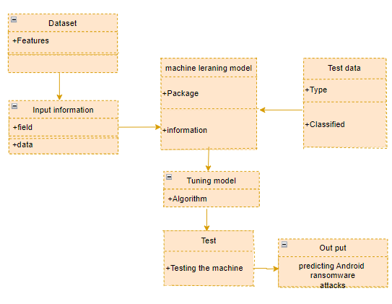
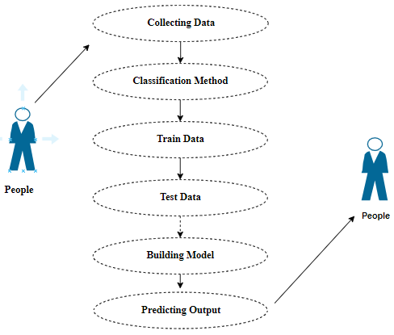
USECASE DIAGRAM
CLASS DIAGRAM

Slide 34
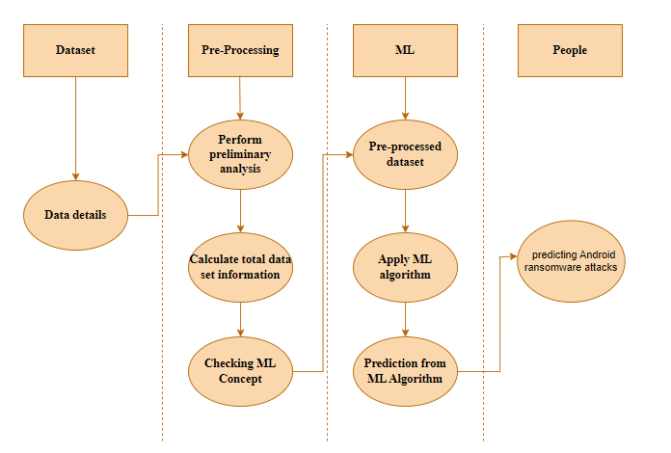
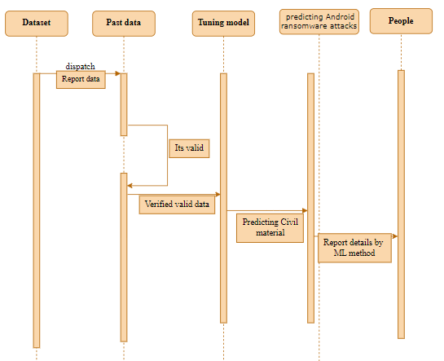
ACTIVITY DIAGRAM
SEQUENCE DIAGRAM

Slide 35
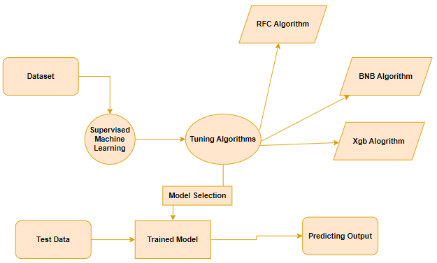
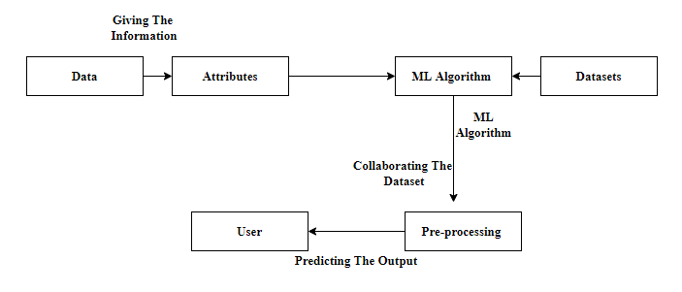
ENTITY RELATIONSHIP DIAGRAM
COLLABARATION DIAGRAM

Slide 36
SCREENSHOTS

Slide 37


Front page
SignUp page

Slide 38


Introduction page
About Page

Slide 39
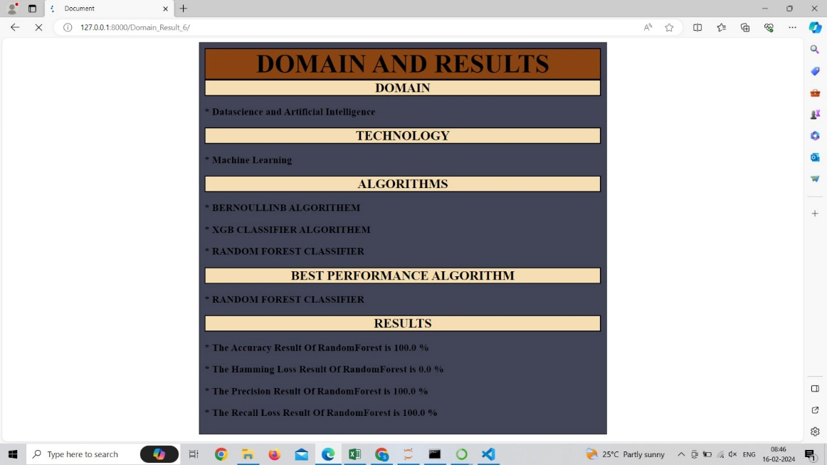

Domain and Results page
Team menbers page

Slide 40
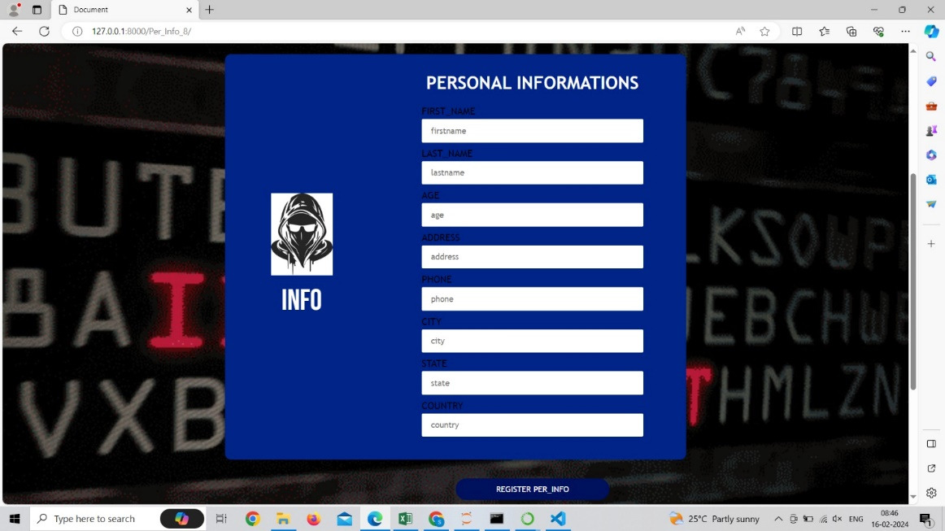
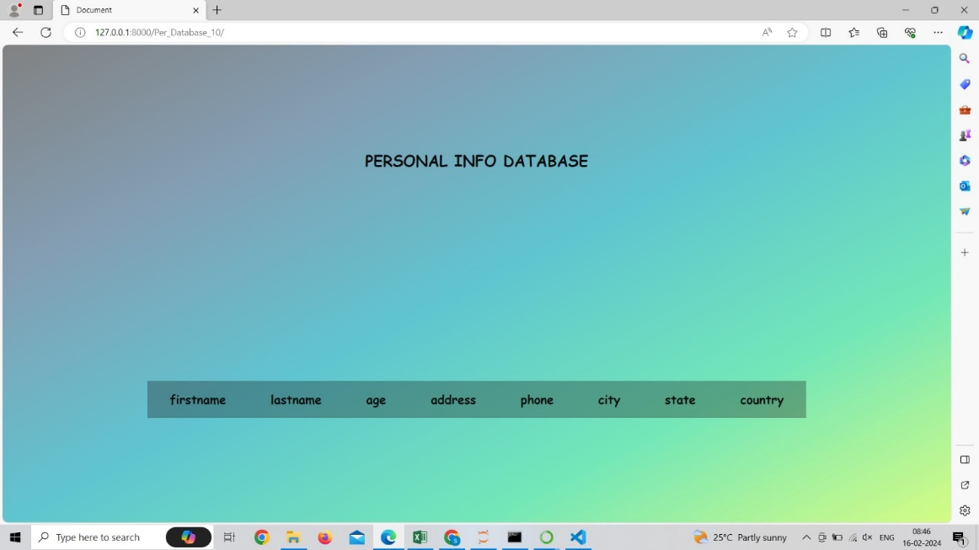
Personal Information page
Personal Information DB page

Slide 41
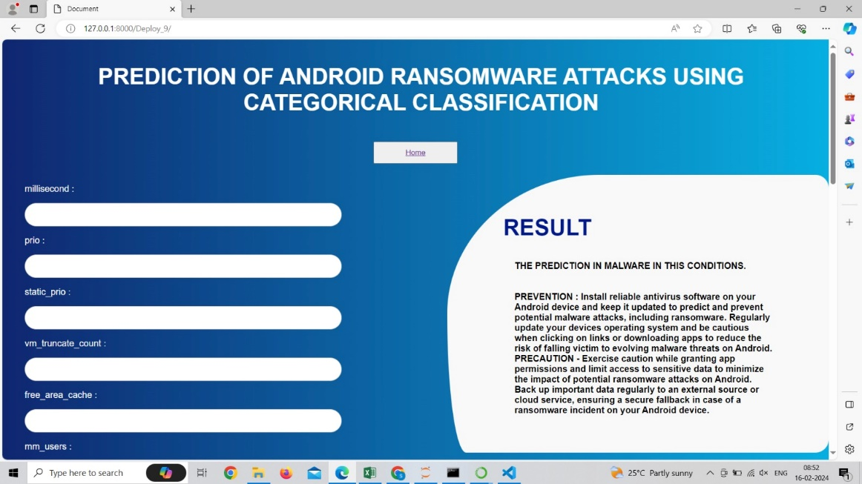

Slide 42
CONCLUSION
In conclusion, predicting Android ransomware attacks through categorical classification emerges as a pivotal strategy for bolstering mobile security.
The use of machine learning models in predicting Android ransomware attacks is a crucial strategy for improving mobile security.
This method enables early detection and risk assessment, prioritizing user protection against evolving threats.
The model's adaptability and seamless integration into the Android security ecosystem demonstrate its proactive stance.
Overall, the application of categorical classification in predicting Android ransomware marks a significant advancement in fortifying the platform against cyber threats, showcasing the efficacy of machine learning in safeguarding mobile ecosystems.

Slide 43
FUTURE WORK
Future work in the realm of predicting Android ransomware attacks using categorical classification should focus on refining the model's predictive accuracy through more sophisticated behavioral analysis and feature engineering.
Incorporating real-time monitoring capabilities and automated response mechanisms would elevate the system's agility in countering emerging threats promptly.
Continuous updates to the dataset, collaboration with cybersecurity communities for real-time threat intelligence, and user education features remain pivotal for ensuring the model's adaptability to the dynamic landscape of Android applications.
Furthermore,considering cross-platform adaptation to other mobile operating systems would broaden the model's scope and contribute to a more comprehensive defense against ransomware threats across diverse platforms.

Slide 44
THANK YOU!!!

